Slide 1
Acceleration Data Structures
CS123

Slide 2
Lecture Roadmap
Introduction/Motivation
Bounding Volume Hierarchy
Grid/Voxel
Octrees
Kd-Trees/ Surface area heuristic
Other acceleration data structures
Miscellaneous optimizations

Slide 3
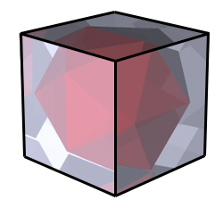
Bounding Volumes
Extents and bounding volumes:
enclose complex objects in simpler ones
e.g. spheres, cuboids
if bounding volume isn’t visible, neither is object inside it!
more efficient: put multiple objects into one volume
How does this speed up raytracing?
quick reject: check ray against bounding volume first
quicker reject: check group of rays (frustum) against bounding volume of object
Easy to implement and can offer noticeable speedups
Particularly easy to implement: Axis-Aligned Bounding Boxes (AABBs)
AABB is a cuboid such that each edge is parallel to either the x, y, or z axis
Calculate by finding the min and max X/Y/Z for each vertex
Works well if object has tight bounding box

Slide 4
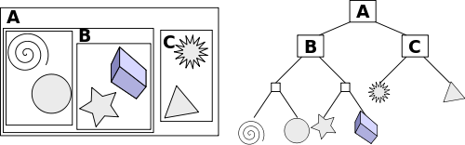
Bounding Volume Hierarchy (1/3)
A technique for organizing the entire model:
Put bounding volumes in other bounding volumes to create a tree hierarchy
bottom-up construction
Repeatedly group bounding volumes of nearby objects together until entire scene is bounded
finding objects that are close to each other can be very difficult (naïve O(n²), can be done in O(n logn) with sorting)
Problem of having tight bounding boxes worsens.
Could use original scene graph: bounding volumes at nodes = union of child bounding volumes
easy to construct…
scenegraph may be logically organized but may not be spatially organized
http://en.wikipedia.org/wiki/Bounding_volume_hierarchy

Slide 5
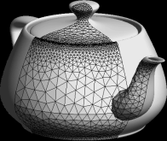
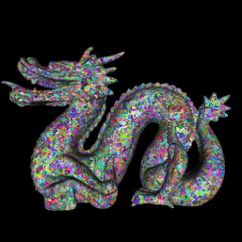
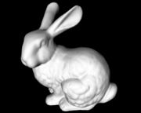

Bounding Volume Hierarchy
Ray Tracing: if ray intersects parent, check children, if not, discard parent

Slide 6
Bounding Volume Hierarchy (3/3)
BVH can work very well for a subset of scenes and is easy to implement.
Performance can improve a lot with additional user input
the scene gives better clues how to group objects
works well for video games (you know the scenes beforehand)
Does not handle arbitrary scenes
will have no performance gains for some scenes, e.g.:
close-up of very detailed mesh
landscape with grass and trees

Slide 7
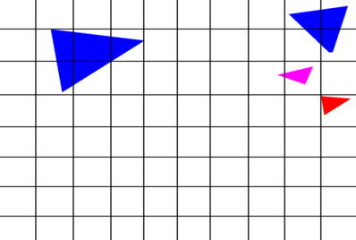
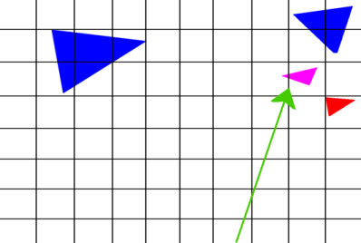
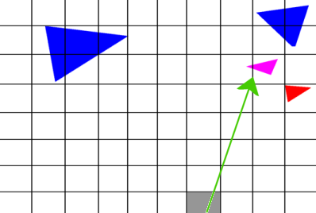
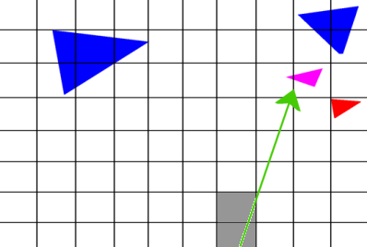
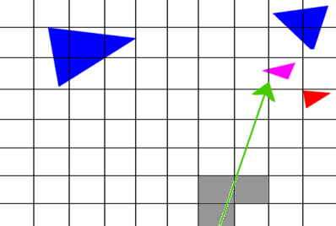
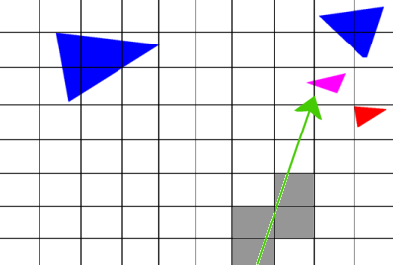
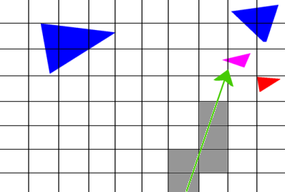
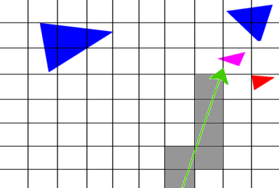
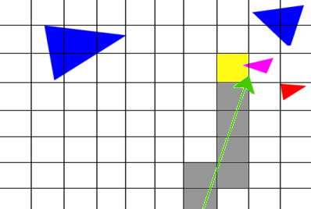
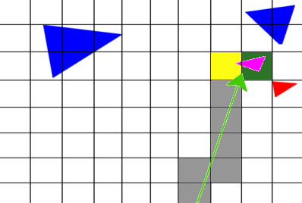
Grids (1/2) – Partitioning Space
Instead of bounding objects bottom-up, break up space into regularly-sized cells
easy/fast to construct -- great for animated scenes
can use line-scanning algorithms for traversal
think of cells as pixels and ray traversal as scan-converting a line
because of this, can be easily implemented in hardware

Slide 8
Grids (2/2) – Pros and Cons
Balance Issues: some cells are clearly more important than others
a lot of cells have nothing in them, waste of resources to check them all
Use larger cell sizes?
but then some cells could also have too many objects
Use smaller cell sizes?
how to determine the best cell size?
Why don’t we just use a finer grid?
expense of stepping through grid cells during traversal
analogous to super-sampling from image processing unit: increasing resolution on monitors decreases visible effects of aliasing, but only at the expense of a significant amount of overhead (memory/processing)
Not hierarchical: more traversal time, but less construction time
useful for animated scenes: moving one object does not affect other objects in grid
In general, however, we’d like a smarter, more adaptive solution

Slide 9
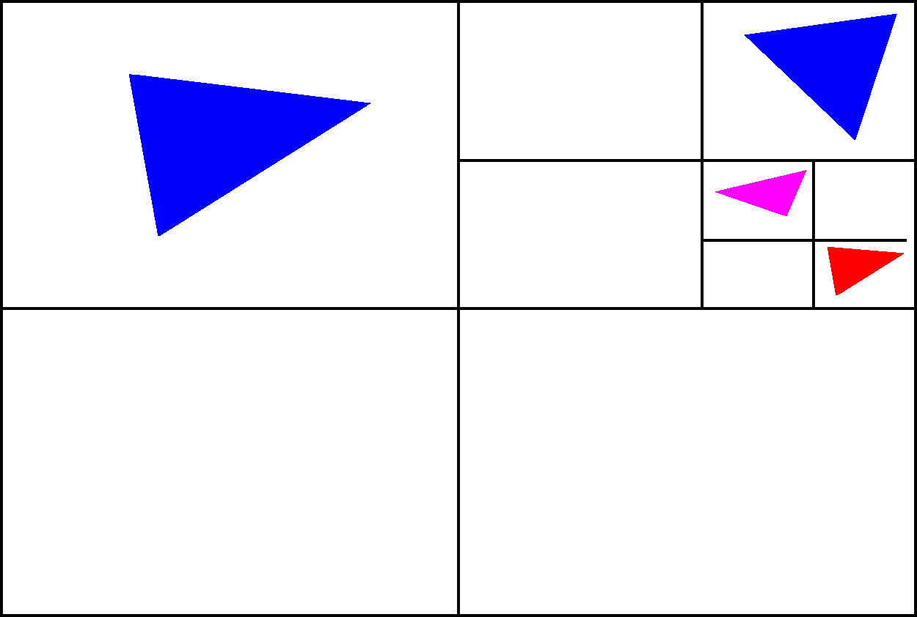
Octrees (1/5) – Adaptive Data Structures
Combine advantages of BVH and grids
Octrees are based on Warnock’s algorithm for hidden surface removal
scene agnostic (grids)
adaptive and hierarchical (BVH)
viewer independent
Similar to grid except voxels do not have to be the same size.
Areas with greater density have more voxels
All nodes in the tree are AABBs
2-D example called a quadtree

Slide 10
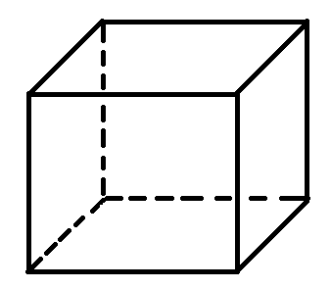
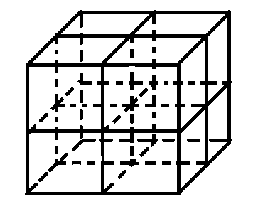
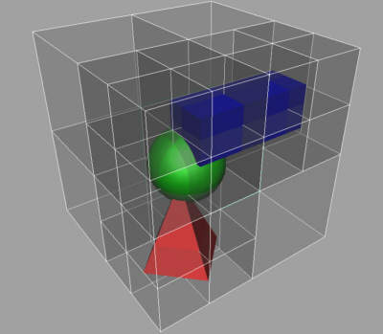
Octrees (2/5) – Construction
Rather than bottom up construction (BVH), construct top down.
Find the bounding box of the entire scene
this is the root of the tree and contains all the primitives
At every iteration, partition the current node into 8 octants
easy to do if bounding boxes are axis aligned
Split the primitives at the current node into the octants
if a node spans both sides of a split, put it in both octants
recur on the new nodes
terminate at a maximum depth or if a voxel has sufficiently few primitives
Variations that can have slightly better performance
don’t subdivide empty nodes

Slide 11
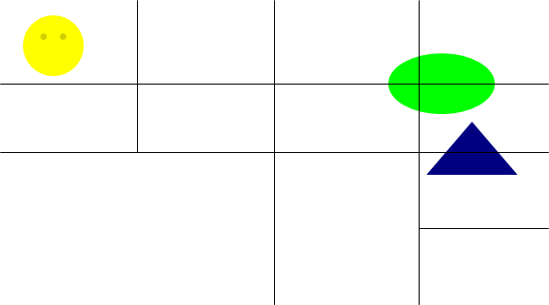
Octrees (3/5) - Traversal
Begin at the root node.
If node is a leaf node, perform intersection on all of its children.
Otherwise, iterate through the node’s children and compute intersection between ray and child’s bounding box
if it intersects, recur on child

Slide 12
Octrees (4/5) - Traversal

Slide 13

Octrees (5/5) - Summary
Octrees are able to handle arbitrary scenes with good performance
Expected runtime O(log n) per ray.
exponential speedup over linear solution
For scenes where primitives are distributed very non-uniformly, octrees will perform terribly
in practice, these scenes are fairly common
octrees can take many subdivisions to zone in on complex geometry, yielding deeper, inefficient trees

Slide 14
kd-trees (1/7) - Motivation
Need to be smarter about how to determine sizes of nodes
tradeoff between spending time intersecting with nodes (deep tree) vs intersecting with scene primitives (shallow tree)
isolate areas of high complexity and produce large empty spaces, which we can step through quickly during traversal
Definition: a kd-tree is a k-dimensional, axis-aligned binary tree
axis-aligned like octree
binary tree unlike octree: choose one axis to split along at each node
Main challenge with kd-trees used for spatial partitioning is determining where to position the split plane at a given node (including which axis to split along)
would like split plane to reflect geometry of objects
degenerate kd-tree is identical to its octree equivalent
let’s look in-depth at how we would select one split for a single node

Slide 15
kd-trees (2/7) – Choosing a split plane
y=1
0
x=1
Split at middle?
During traversal, ray is equally likely to enter either left side or right side
But cost of entering right side is much higher!
How do we split up this “node” in space optimally?

Slide 16
kd-trees (2/7) – Choosing a split plane
y=1
0
x=1
Split at median?
Cost of entering each side during traversal in terms of possible intersection tests is approximately equal
But a ray is much more likely to enter left-hand side – much greater area!

Slide 17
kd-trees (2/7) – Choosing a split plane
y=1
0
x=1
Cost-Optimized Split
Attempts to balance the cost of entering a node (intersection tests) with probability of entering that node
Isolates geometric complexity rapidly, creating large, empty nodes that can be quickly discarded during traversal

Slide 18
kd-trees (2/7) – Choosing a split plane
y=1
0
x=1
Where to split children?
Left child requires no further subdivision
Right child split roughly at middle/median
No clear winner for future splits in right child; will look mostly like octree from this point onwards (objects now uniformly distributed)
Difference is that we have isolated this geometry after only one split whereas octree would take longer (deeper tree and slower to traverse).

Slide 19
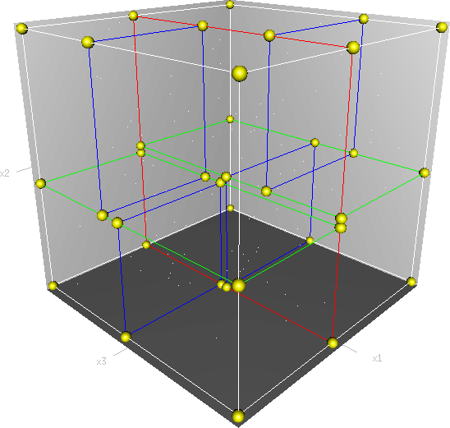
kd-trees (4/7) - Construction
Pseudocode for constructing kd-tree:
Selecting a good split plane is crucial to performance.
Constructing cost-optimal kd-tree is NP-complete, so we do the best we can locally at a given node and use a greedy Surface Area Heuristic as an approximation (next slide)
Given AABB of current node and list of primitives L
if there are too few primitives
create leaf node and return
else
choose split axis a (i.e. one of the k dimensions)
choose split plane p (along axis a)
determine which primitives in L intersect left
child and right child respectively
recursively subdivide left child
recursively subdivide right child
►

Slide 20
kd-trees (5/7) – Surface Area Heuristic
Pseudocode for construction with SAH:
Probability calculation assumes rays will be distributed evenly throughout space
Prob_{child} = ratio of child AABB’s surface area to parent node’s surface area
Cost_{child} = number of primitives contained in child
Prob_{child} * Cost_{child} = Expected cost of entering child node
Given AABB of current node and list of primitives L
for each possible split position (see next slide)
cost = C_{traversal} + Prob_{left} * Cost_{left} + Prob_{right} * Cost_{right}
use split plane which minimizes this cost

Slide 21
kd-trees (5/7) – Surface Area Heuristic
Number of possible split positions is infinite
which ones should we consider?
only consider splits at edges of primitives along the split axis
Complexity analysis: do high construction costs nullify the advantage we gain during traversal?
naïve construction takes O(n² log n)
how can we make construction faster?
Sort primitives along split axis, iterate through until surface area heuristic is met
takes O(n log² n)
memory I/O is generally the limiting factor

Slide 22
kd-trees (6/7) - Traversal
Can use identical traversal algorithm as octree
Early termination
Instead of traversing the two children in arbitrary order, pick the child that will be hit by the ray first.
first child is called the “frontside child”
second child is the “backside child”
If there is an intersection in the frontside child that is earlier than the intersection to the backside child’s bounding box, no need to traverse backside child
this technique also applies for previous data structures

Slide 23
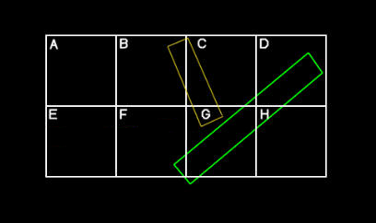
kd-trees (7/7) – Edge Cases
Traversal edge cases – must be really careful when early termination is safe
The ray traverses node F before node G. When traversing F, the ray intersects the green rectangle but you can not terminate yet.
Must compare intersection t values with t values for bounding boxes.
During construction, what happens if the primitive is in the split plane?
Put object in both sides? Choose one?
Rays that are inside/parallel to split plane

Slide 24
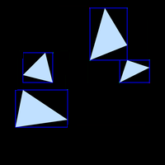
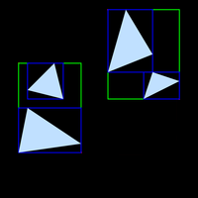



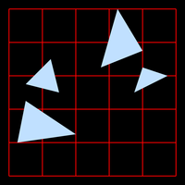
Summary of Acceleration Data Structures (1/2)
Bounding Volume Hierarchy
Grids

Slide 25


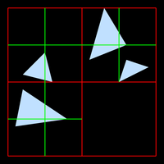


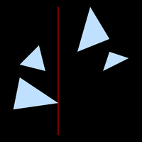


Summary of Acceleration Data Structures (2/2)
Octrees
kd-tree

Slide 26
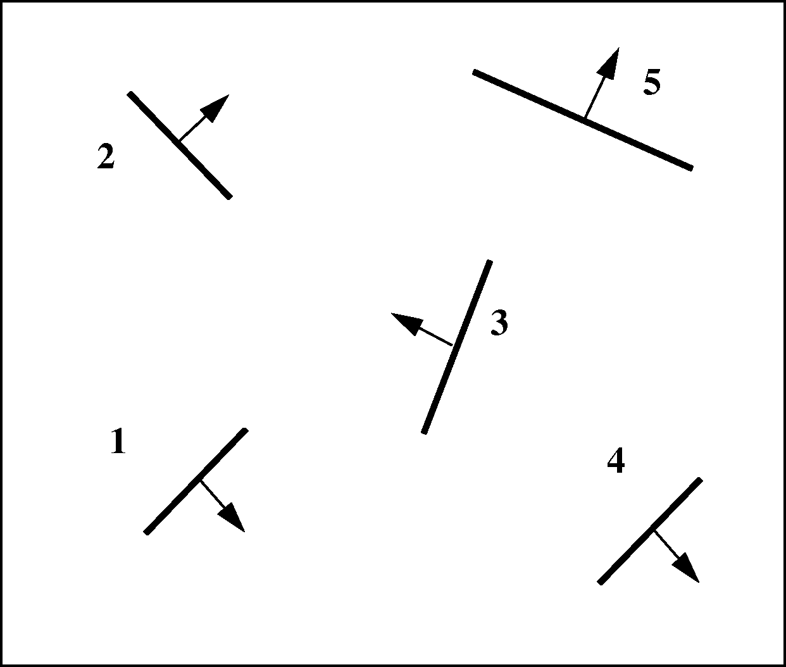
Binary Space Partitioning Trees (BSP) (1/7)
Used for polygon Visible Surface Determination (not raytracing)
Replaces z-buffers in determining order in which objects are drawn first
Construct a binary tree with spatial subdivision
non axis-aligned version of kd-tree
no cost evaluation; choose split plane arbitrarily
BSP-0:
Initial Scene

Slide 27
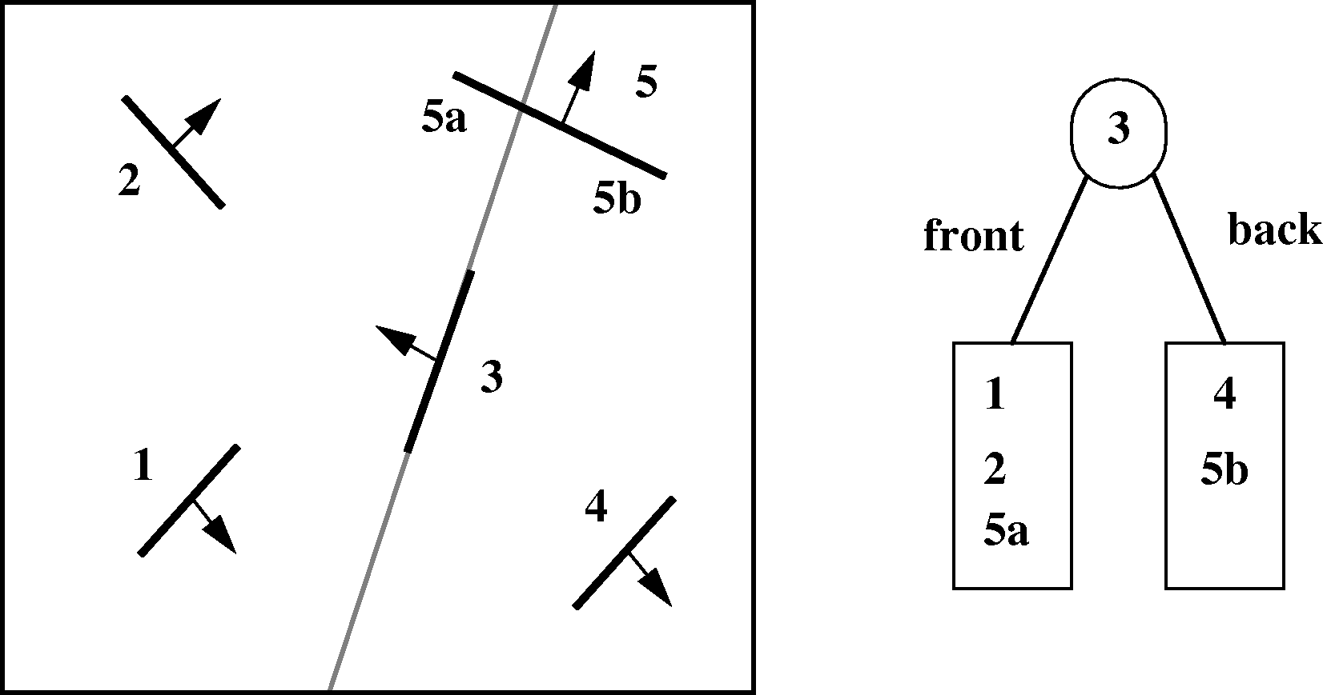
BSP Trees (2/7)
BSP-1: Choose any polygon (e.g., polygon 3) and subdivide others
by its plane, splitting polygons when necessary

Slide 28
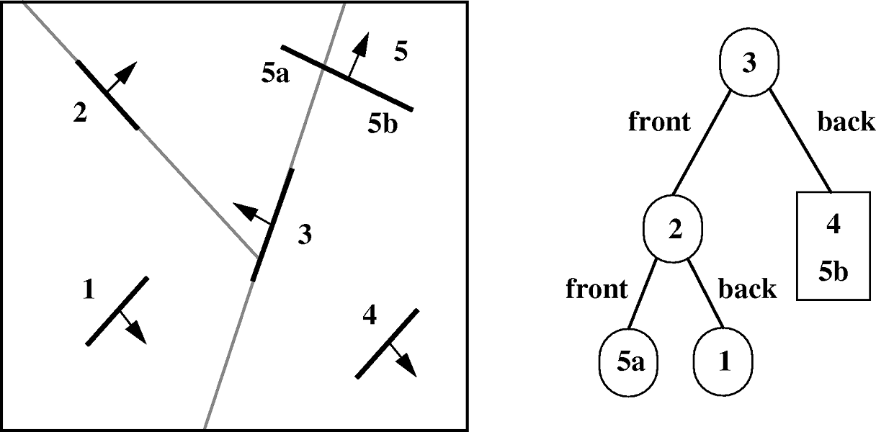
BSP Trees (3/7)
BSP-2: Process front sub-tree recursively

Slide 29
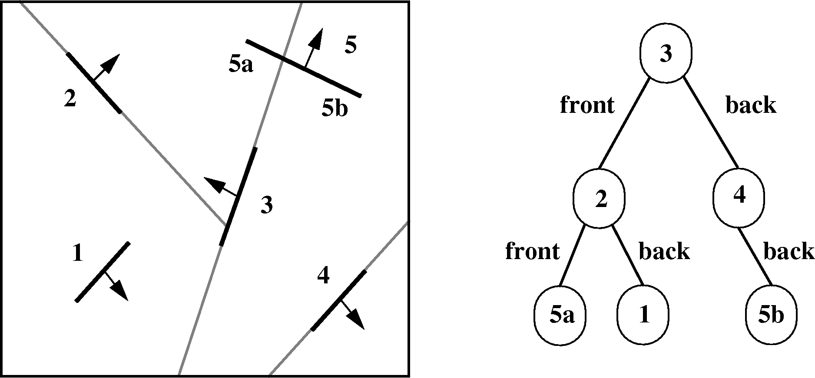
BSP Trees (4/7)
BSP-3: Process back sub-tree recursively

Slide 30
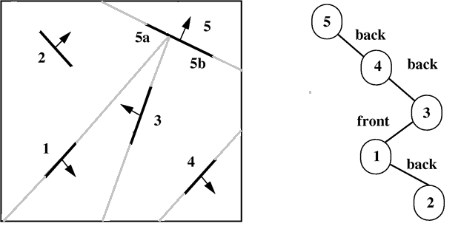
BSP Trees (5/7)
BSP-4: An alternative BSP tree with polygon 5 at the root

Slide 31
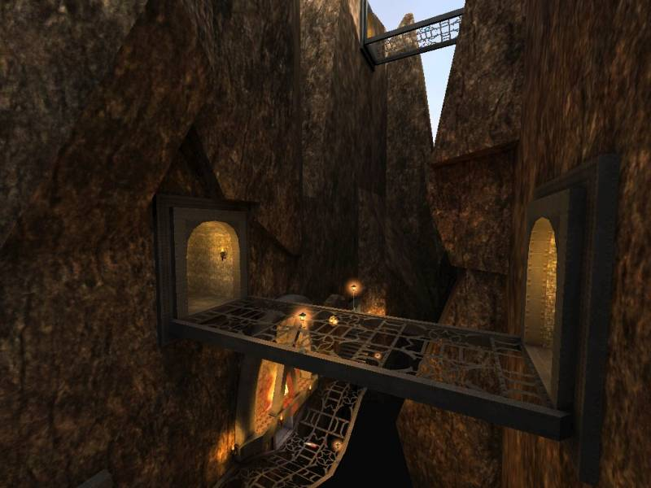
BSP Trees (6/7)
kd-tree visited nodes front-to-back during raytracing traversal
BSP nodes are visited in back to front order. The back child of a node is the side that doesn’t contain the viewpoint (view-dependent)
Very fast to build. Quake III uses this for occlusion culling and to speed up intersection testing

Slide 32
BSP Trees (7/7)
void BSP_displayTree(BSP_tree* tree) {
if ( tree is not empty )
if ( viewer is in front of root ) {
BSP_displayTree(tree->backChild);
displayPolygon(tree->root);
BSP_displayTree(tree->frontChild);
}
else {
BSP_displayTree(tree->frontChild);
// ignore next line if back-face
// culling desired
displayPolygon(tree->root);
BSP_displayTree(tree->backChild);
}
}
}
BSP applet : http://symbolcraft.com/graphics/bsp/index.html

Slide 33
Quiz
Which data structure(s) are best-suited in the following situations?
An animation where only the camera moves?
kd-tree
A fast-paced video game with lots of interactive, moving objects?
grid
BSP-Tree
A very balanced and even scene with objects uniformly distributed throughout the whole scene?
octree
Rendering scenes in a Pixar-like movie?
depends on the shot; most likely a combination of techniques are used
Your ray-tracing assignment in CS123?
kd-tree

Slide 34
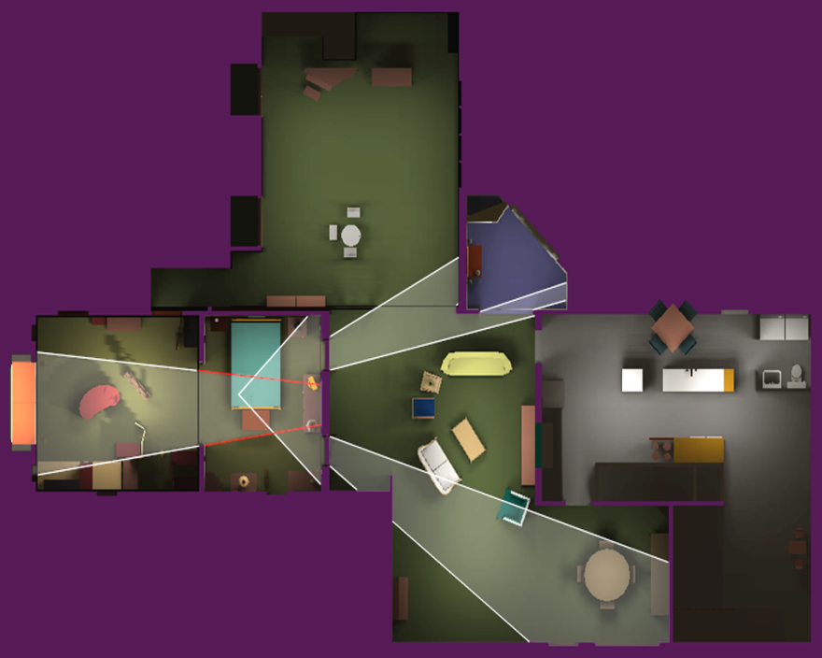
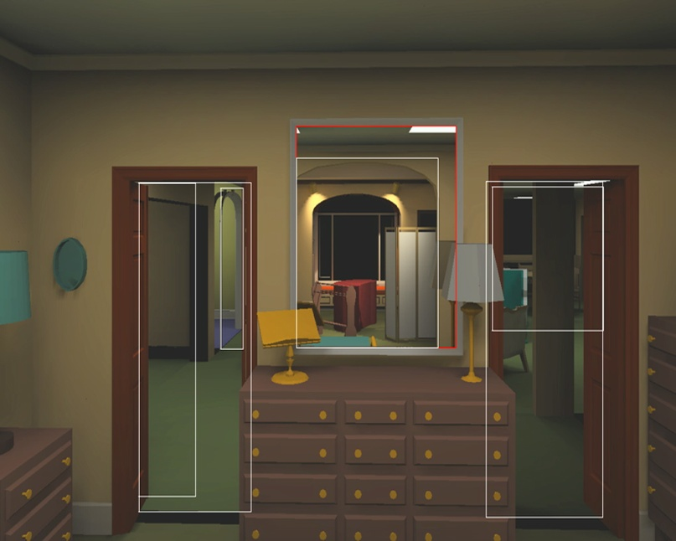
Advanced Techniques (1/2) - Portals
Indoor spaces are mostly rooms with doorways
Why draw the geometry in the next room if the door is closed?
If there is a portal (open door or hallway) only need to draw geometry visible through the door
Determining this information is useful as a pre-computation step – geometry visible through a portal remains constant. Not too good for outdoor scenes
Picture Courtesy: David P. Luebke and Chris Georges, “Simple, Fast Evaluation of Potentially Visible Sets” http://www.cs.virginia.edu/~luebke/publications/portals.html

Slide 35
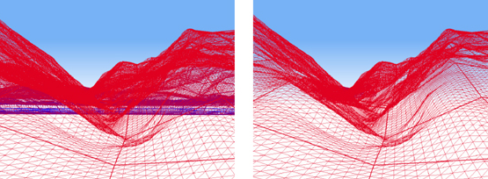
Advanced Techniques (2/2) – Occlusion Culling
If a big object fills a good portion of the screen, don’t draw geometry that it covers up
Many new graphics cards have support for parts of the process
Algorithm:
Create list of all objects potentially visible in frustum (per polygon or per shape)
For each pair of objects i and j, if i occludes j (i.e. i lies in j’s shadow volume) remove j
Can clip conservatively by comparing frustum projection against projection onto ground plane
O(n²)! Lots of ways to make this faster:
Coorg, S., and S. Teller, "Real-Time Occlusion Culling for Models with Large Occluders", in 1997 Symposium on Interactive 3D Graphics
Gamasutra overview of Occlusion Culling algorithms: www.gamasutra.com/features/19991109/moller_haines_01
Bad for indoor scenes with lots of small objects
Without OC – lots of geometry drawn, most is not seen (drawn in blue)
With OC – algorithm ignores blue geometry behind the hills

Slide 36
Other Simple Optimizations
Mailboxing¹
Shadow caching¹
Compact node formats¹
Contiguous memory layout
Multithreading
Makes mailboxing tricky
Packet traversal
SIMD
Combining spatial data structures
BVH + kd-trees
More efficient ray-primitive intersections
Slab method for boxes¹
Barycentric coordinates for triangles
Using these techniques, state of the art ray tracing engines are able to get ~10fps on scenes with 100K primitives
PhD thesis by Ingo Wald describes these optimizations in more detail and has coding examples
1: Easy to implement in your raytracer for CS123

Slide 37
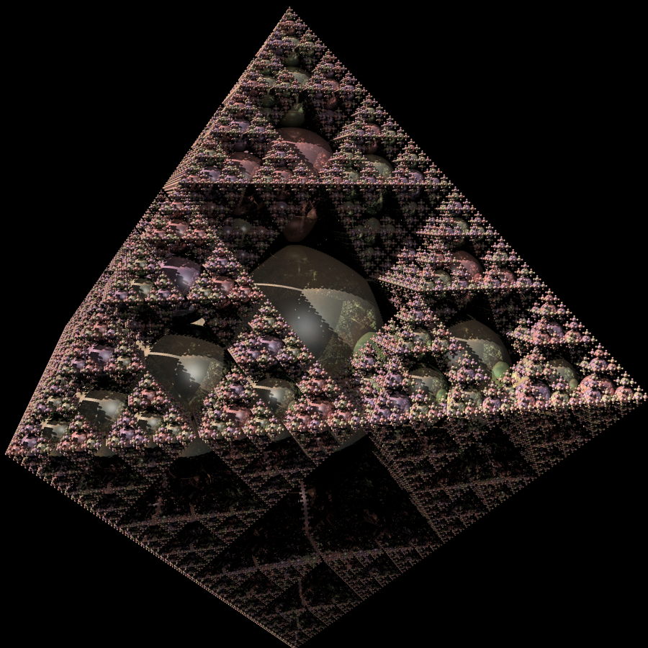
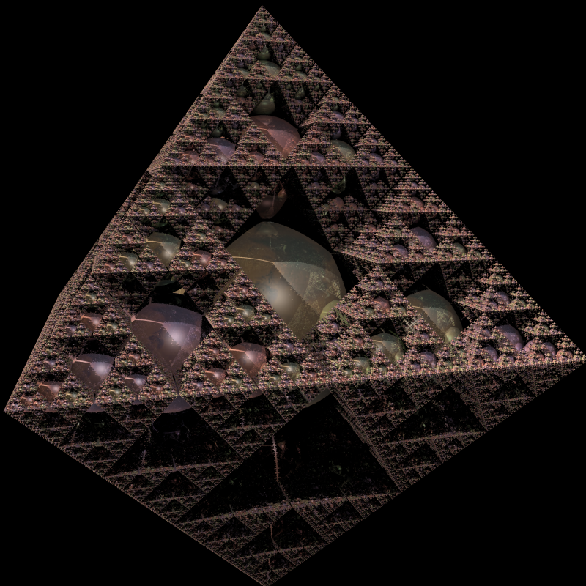
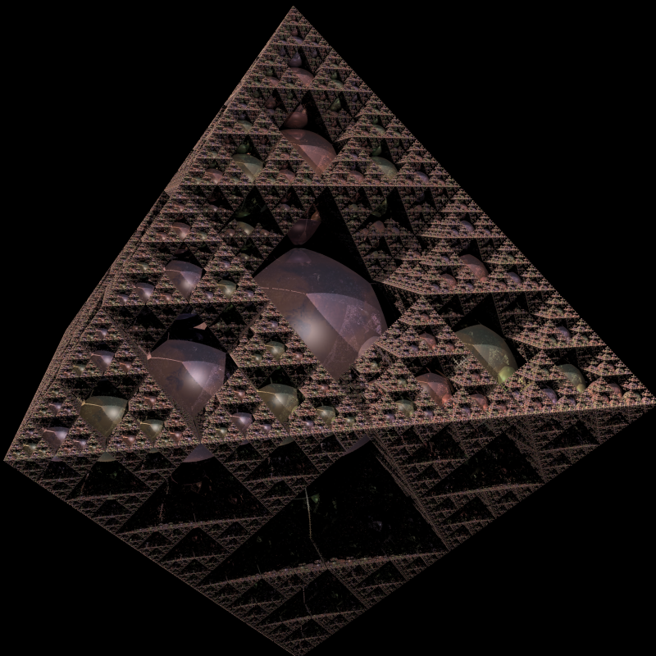
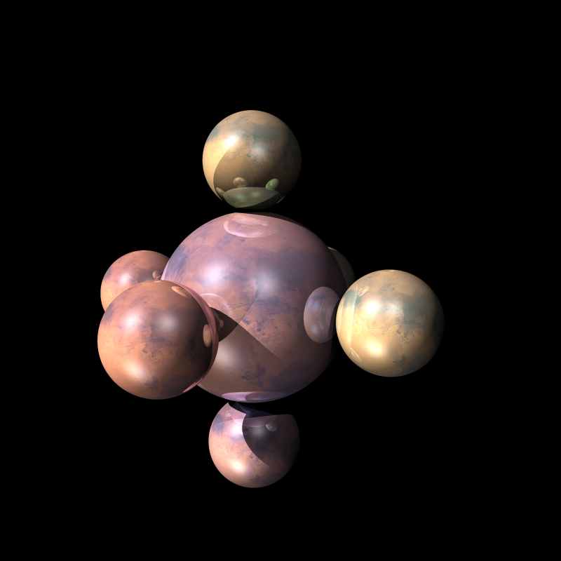
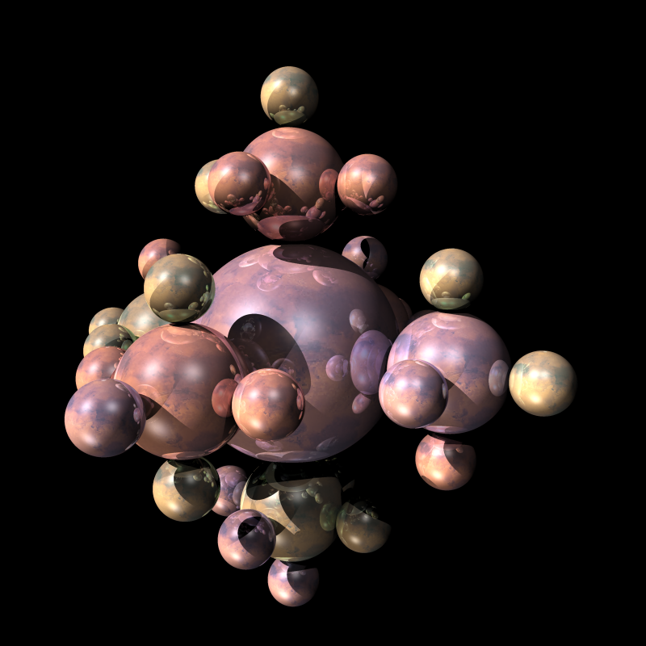
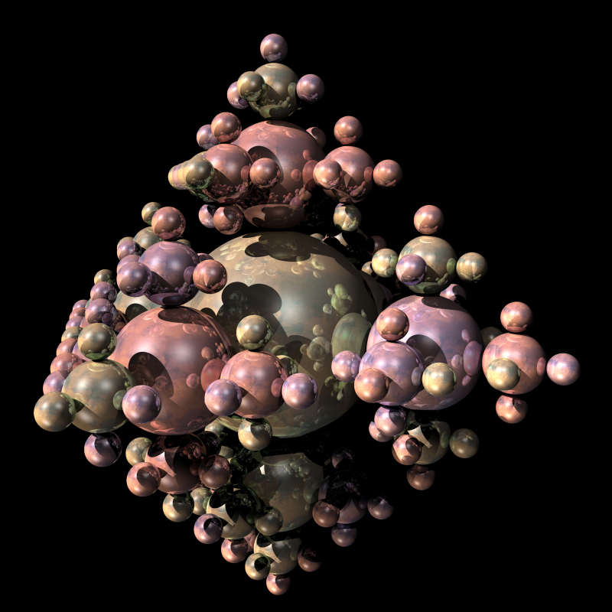
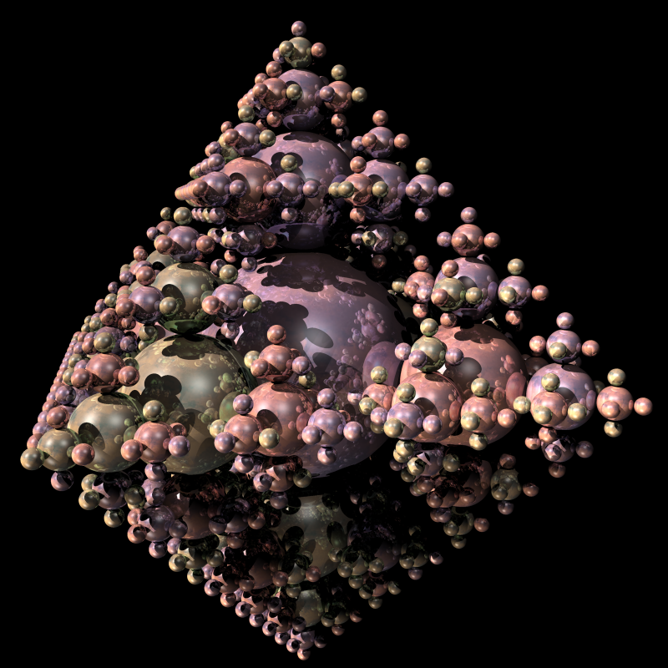
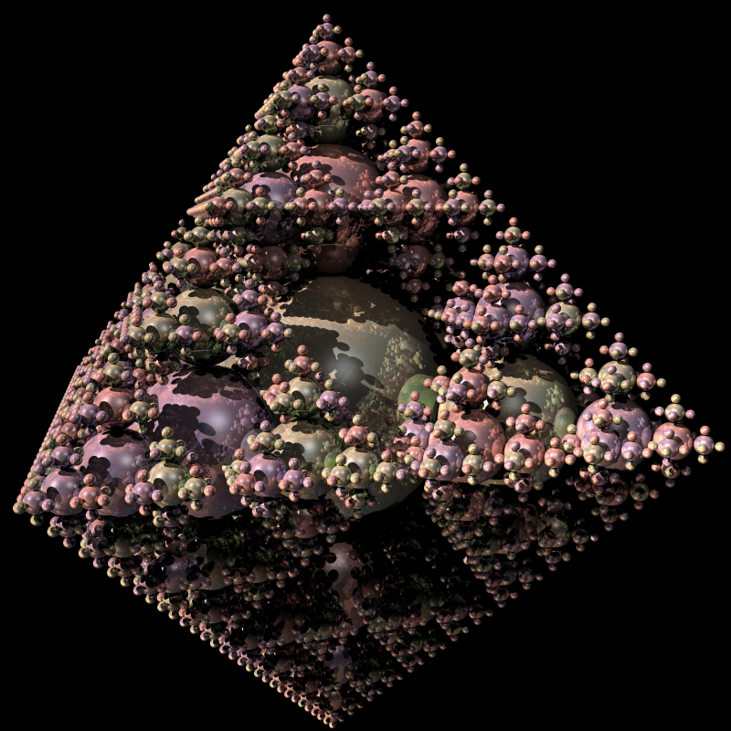
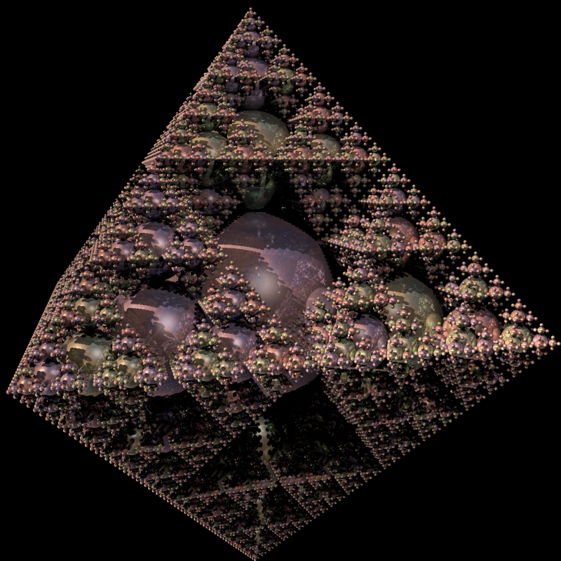
Example
Primitives: 7 Spheres
Render Time: 16 secs
Primitives: 187 Spheres
Render Time: 43 secs
Primitives: 937 Spheres
Render Time: 52 secs
Primitives: 23437 Spheres
Render Time: 135/6 secs
Primitives: 4687 Spheres
Render Time: 85/2 secs
Primitives: 585937 Spheres
Render Time: 14/6 min
Primitives: ~3M Spheres
Render Time: 18min/4.5 hours
Primitives: 117187 Spheres
Render Time: 212/80 secs
Primitives: 37 Spheres
Render Time: 22 secs

